Slide 1
Formal Methods in S.E
Formal: Definite, orderly, methodical
F.M is a branch of CS or S.E we specify,construct n argue/analyze programs by mathematical techniques. (Dijekstra and Tony Hoer)
Specify: Student name < 40 chars
CPGA>2 && CGPA <=4.0
Notes:
S/w is present in every field of life. It is controlling a huge list of hardwares and systems etc. A small mistake in the s.w can cause a lot of damage. In order to minimize or protect from this damage we need to engineer s/w system by a Formal or Reliable manner that can guarantee that it is bug free.
Formal means something that is done with discipline. Upper def. now in s/w eng these techniques r used to specify programs i.e the meaning of what the program is supposed to do.
Constructing program: That is we write the program in a way that each step leads us to final correct solution. That is we do not take any rong stpe
Argue : Once the program is written, v can do its verification ie. how do we prove that program will fullfill the specifications or the requirements

Slide 2
Formal Methods in S.E
Formal Methods in Software Formal methods are used to:
1. Specify (What it does)
2. Develop
3. Verify (for correctness/proof against specification)

Slide 3
Why we study Formal Tech;
To develop reliable systems. Otherwise even a small error/bug can create huge loss including financial, economical and loss of humain lives. E.g. a microwave oven controlled program can cause it to be explode if contains a bug.
To ensure s/w quality that have no bugs.
Notes:
That is whats wrong with we already do called informal.

Slide 4
Reliability of Crucial Systems
Real Time app: Must respond within a specific time frame
Mission Critical System:
Notes:
RealTime software is software which fails if a timing deadline is not met. E.g. Car airbag system. An industrial safety system such as oil and gas plants and nuclear plants. They are used to protect human, industrial plant, and the environment in case of the process going beyond the allowed control margins.
The software which handles banking transactions (in the millions of dollars) is mission-critical but not real-time. If it fails, severe financial losses would result. However, there isn't any time interval in which a transaction must complete, else the system is considered to have failed.
Mission critical : A system is mission critical if the entire reputation of org (in which it is working) is at stake without it. A mission-critical data center is one on which an entire company depends. It is the core of every business that operates with data. Such data centers could be in a hospital to help manage patient records and to keep equipment online. It might also be at the heart of the stock exchange. If data centers for either of these examples shut down, there would likely be a lot of chaos.
The mission-critical server is a system whose failure may result in the failure of some goal-directed activity. An example of a mission-critical system is a navigational system. Or control systems for aircraft.
A system may be considered mission critical for example if Human life or safety is at risk and dependent on it.

Slide 5
How to make reliable s/w
1st solution is Testing: But, How many test case we must develop to prove that the program is correct?
Can we thoroughly test the s/w that can ensure the absence of bugs?
You can only prove the presence of bug by Testing, But you van never prove the absence of defect. Testing can only show if there is a bug in s/w, but Testing can never show that there is no bug. If testing does not uncover any of the defects that does not mean that there are no defects in the s/w.

Slide 6
Black Box Testing
Program to test for two equal strings
Test cases:
isEqual (“cat”, “dog”) - expected false
isEqual (“Testing”, “Testing”) - expected true
isEqual (“house”, “home”) - expected false

Slide 7
equal = strlen(string1) == strlen(string2);
if (equal)
for (i = 0; i < strlen(string1); i++)
equal = string1[i] == string2[i];
return equal;

Slide 8
WhiteBox/Structure Testing
Covers:
1.Statement Coverage
2.Branch Coverage
3.Path Coverage
Problem?
Can we enumerate all paths?

Slide 9
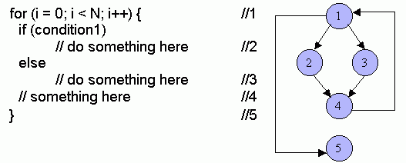
2^{N} Paths

Slide 10
Formal Methods
In order to build reliable high quality system We need to develop system models by mathematical techniques and then we argue about the correctness of those models by mathematical formulas.
System Model: Helps us to argue about the correctness of s/w or program
Notes:
How to apply the formal techniques to build the model and then argue about those models.
What is a model? And why do v actually need a model and how does this model actually helps us. See it by D game.

Slide 11
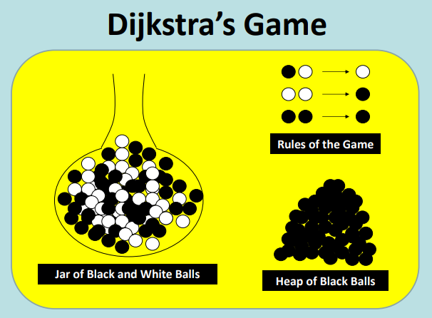
Notes:
V have a JAR of black and white balls we pick 2 balls from the jar if
Both are of same color: we put black ball in the Jar: in order to support this condition suppose we hve a lagre amount of black balls available separately
If different color: we put a white ball back in the Jar
What will be the color of last ball?
Will the program ever terminates?
Yes because we are decreasing one ball from the jar at each move, hence we must left with Last ball in the future.
Given the number of W white and B black balls in the JAR can we determine the number of last balls?

Slide 12
1 Ball Game
Game terminates with the color of ball inside the Jar.
Notes:
Suppose there is a single ball in the Jar

Slide 13
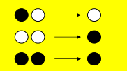
2 Ball Game
Notes:
Suppose there are 2 balls in the Jar

Slide 14
3 ball Game
Notes:
Hint: The color of the last ball is dependent upon the parity of white balls in the JAR. That is , It is the number of the white balls that determines the color of last ball.
If there is even number of white balls we will left with the BLACK ball in the JAR and if it is odd then we will left with a white ball in the jar.
Question: How many games we should play to be sure about this argument/Hypothesis? Will we play 4 ball game 5 ball game 6 ball game? It is so cumbersome n time consuming plus informal.
We need to have a formal proof of this hypothesis. That is we need to develop a system model of this game. We must specify the requirements in form of maths so that we can have a system model that can later be developed by a program and that can be argued by Formal tool(Logic or set theory etc )

Slide 15
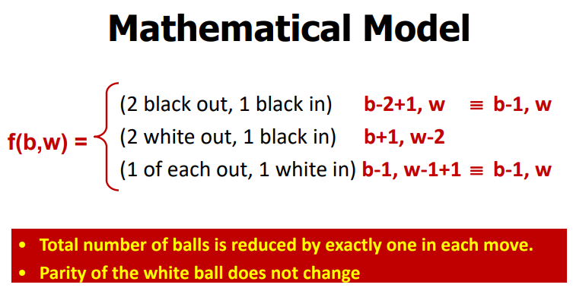
Formal Specification of Dijekstra’s game
Notes:
Suppose that f is a function representing this game having w number of white and and b number of black balls in the JAR.
hence we can write a formal specification of this game by 3 possibilities shown
So, in 2 cases we are reducing the black balls by 1 and maintains the number of white balls in the JAR
And in 1 case we are reducing the number of white balls by 2 and we increased the number of black balls by 1.
Hence , in every case
1:we reduced 1 ball and
2: Either we removed 2 white balls from the jar or we do not remove any white balls from the jar ir the parity of white balls does not change, so the number of white balls are removed by 0 or 2, ie if there were even number of white balls in the jar then they will remain even. And 0 is even number so what ever even number of white balls are there in the jar(2, 200 400) the number of white ball in the last move will be 0. that is an even number.
And if we see towards the black ball then we can see that in all 3 cases black ball is either decreased or increased by 1 so we are not concerned on black ball.

Slide 16
Tools of Formal Methods
Logic
Set Theory
Notes:
Logic and set theory are 2 important tools to build system models and to argue these models(i.e. we will provide the proof of the correctness of the models.)

Slide 17
Design By Contract
Design by contract (DbC), also known as contract programming, is a defect/failure prevention strategy and a FORMAL approach for designing Reliable software that removes self defeating nature of s/w component.
Industry’s most comprehensive method of s/w reliability.

Slide 18
Contract ?
The obligations of client & server is called a C;
Contract involves
1) Two parties(client & server)
2)Benefits and Obligations (Agreement)
Each party gets certain benefits and at the same time there are certain obligations imposed on both parties by this contract.
The obligation of one party is benefit of other.

Slide 19
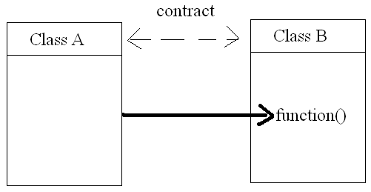
DBC Concept

Slide 20
DBC Concept
The concept is “v have 2 classes A n B. A uses a service of B through its method function()”
Class B Says ” my obligation is that on calling function() I will provide you some results”
Class A Benefits: No code writing in class A just use the servixe of B
Class A obligation: B also put some constraints on class A to use its service this constraint is A’s obligation and B’s benefit

Slide 21
DBC Concept
Now some code is shifted to class A as its obligation, and the code size on B will reduce and B is free of complexity and becomes more reliable and B now just have to take code of its real working not on massive if else codes.

Slide 22
Example
Defensive programming style
Item Stack::pop(){
if(isEmpty()) printf(error u cant pop)
else pop the top element and return it
}
Here server checks whether stack is empty or not if client tried to
pop 4m empty stack then server raises the exception.

Slide 23
Example
DBC style
Require:
Stack not empty: size()>0 //pre cond
Ensures:
pop the element and top-- //post c;

Slide 24
DBC programming mechanism
Pre condition:
Post condition:
Class Invariants:

Slide 25
Pre condition
The obligation of client ie constraint on the client input. The client has to send the parameters according to pre-con. If anything s wrong in calling mechanism then server is not responsible for errors which is server benefits.
So a client must give input according to a pre cond;

Slide 26
Post condition
It is server obligation. We say that on satisfying pre cond; by client when a client provides input to the server to gain its service the server must deliver proper output. The proper output is called post condition. This post condition is a benefit of client.
So a server must provide output as a post condition.

Slide 27
Class Invariants
Pre-conditions and post-conditions describe the properties of individual methods.
A class invariant is a global property of the instances of a class, which must be preserved by all methods. Certain properties/Data of the class must follow some constraints and never violated by methos of any instance of class.
A class invariant is an assertion in the class definition.
E.g. a stack class might have the following class invariant:
count >= 0 and
count <= capacity and
stack_is_empty = (count = 0)

Slide 28
Example
A class representing a range of real numbers:
public class RealRange {
private RealNumber min, max;
public RealRange(RealNumber min, RealNumber max) {
this.min = min; this.max = max;
}
public void setRange(RealNumber newMin, RealNumber newMax) {
this.min = newMin;
this.max = newMax;
}
}
invariant: min <= max.

Slide 29
Example
min<=max could have been a precondition on setrange function but actually it is a class invariant means that all the methods of the class have to fullfil min<=max.
So invariant is a sort of ANDED with the post condition of every function.

Slide 30
DbC and Inheritance
What happens to assertions/Invariants when classes are inherited?
How can assertions be “preserved” in the face of redeclaration (overriding) and dynamic binding?
Actually assertions help maintain the semantics of classes and methods when they are inherited.

Slide 31
Invariants
The invariants of all the parents of a class apply to the class itself.
The parents’ invariants are added (logically “and”ed) to the class’s own invariants.
Class Parent
Class Parent
Attrs …
Attrs …
Methods …
Methods …
Inv: P
Inv: P
⇒
Class Child
Class Child
Attrs …
Attrs …
Methods …
Methods …
Inv: C
Inv: P ∧ C
The parents’ invariants need not be repeated in the class.

Slide 32
Summary
Software reliability requires precise specifications which are honoured by both the supplier and the client.
DbC uses assertions (pre and postconditions, invariants) as a contract between supplier and client.
DbC works equally well under inheritance.

Slide 33
Languages with third-party support:
C and C++: DBC for C preprocessor, GNU Nana
C#: eXtensible C# (XC#).
Java: iContract2, Contract4J, jContractor, Jcontract, C4J, CodePro Analytix, STclass, Jass preprocessor, OVal with AspectJ, Java Modeling Language (JML), SpringContracts for the Spring framework, or Modern Jass, Custos using AspectJ.
JavaScript: Cerny.js or ecmaDebug.
Common Lisp: the macro facility or the CLOS metaobject protocol.
Scheme: the PLT Scheme extension
Perl: the CPAN modules Class::Contract , Carp::Datum
Python, PyDBC , Contracts for Python.
Ruby: Ruby DBC , ruby-contract.

